Slide 1
Data Wrangling with Baltimore City 911 Report Data
By Priyanka Anumandla

Slide 2
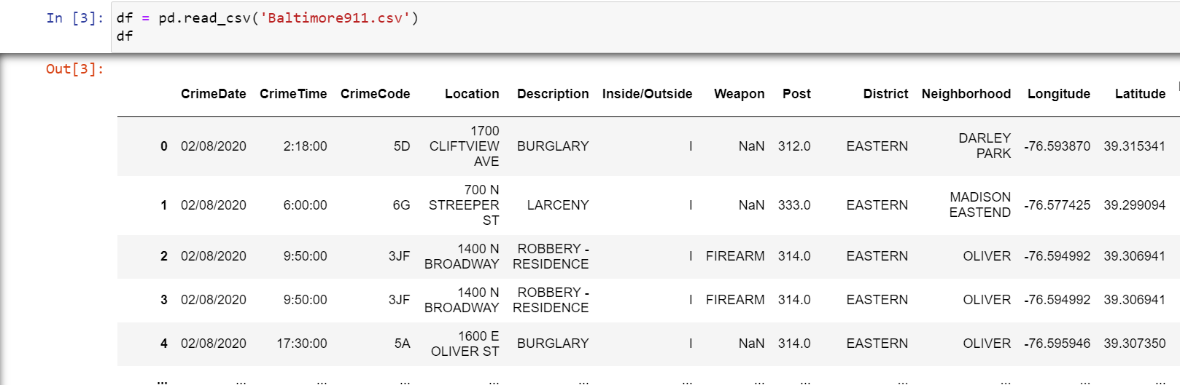
Dataset:
This dataset gives brief information about crime date, crime time, location, attack type, weapon and several other aspects of crime scene. Dataset is named as Baltimore911.csv, it is a combination of numerical, categorical , time format and string data types.

Slide 3
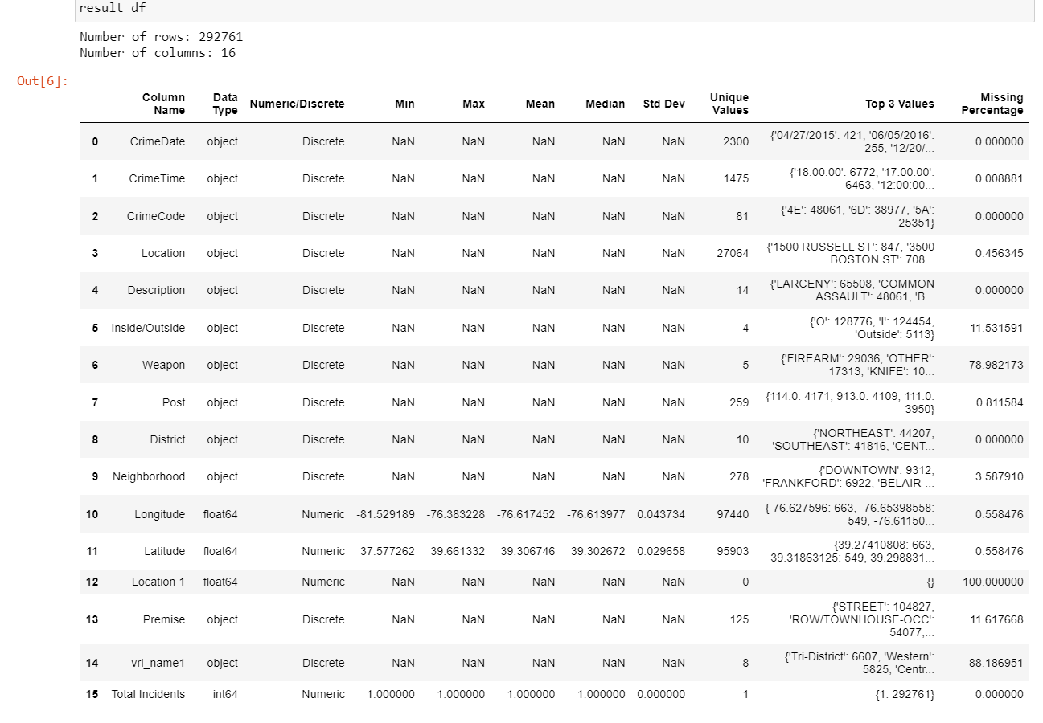
Create a dataset profile table that gives an overview of the dataset.
There are no. missing values in most of the columns except location1.
The "Total Incidents" column appears to be highly imbalanced, with only one unique value (1) making up the majority of the data (100%). This suggests that this column may not be informative for modeling and may need to be further investigated.
The "Inside/Outside" and "Weapon" columns have relatively high percentages of missing values (11.53% and 78.98%, respectively). Depending on their importance, missing data could be imputed or handled using appropriate strategies.

Slide 4
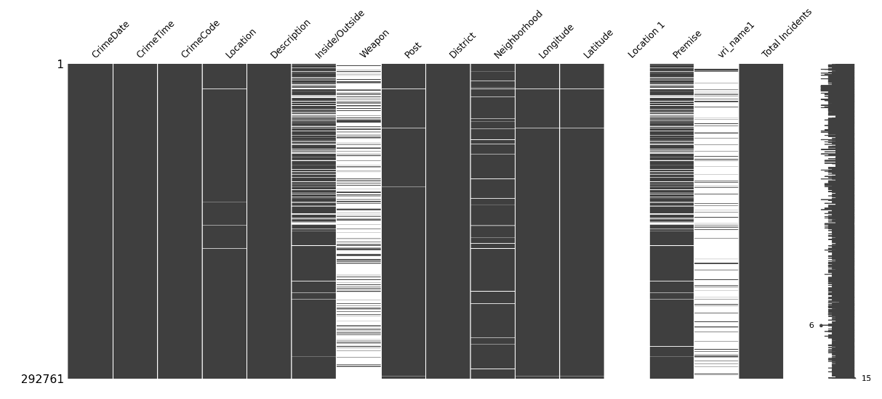
Data cleaning
Dropped the columns which rows are having high missing values. Based on below matrix plot.
Change the datatype from object to other datatype.

Slide 5
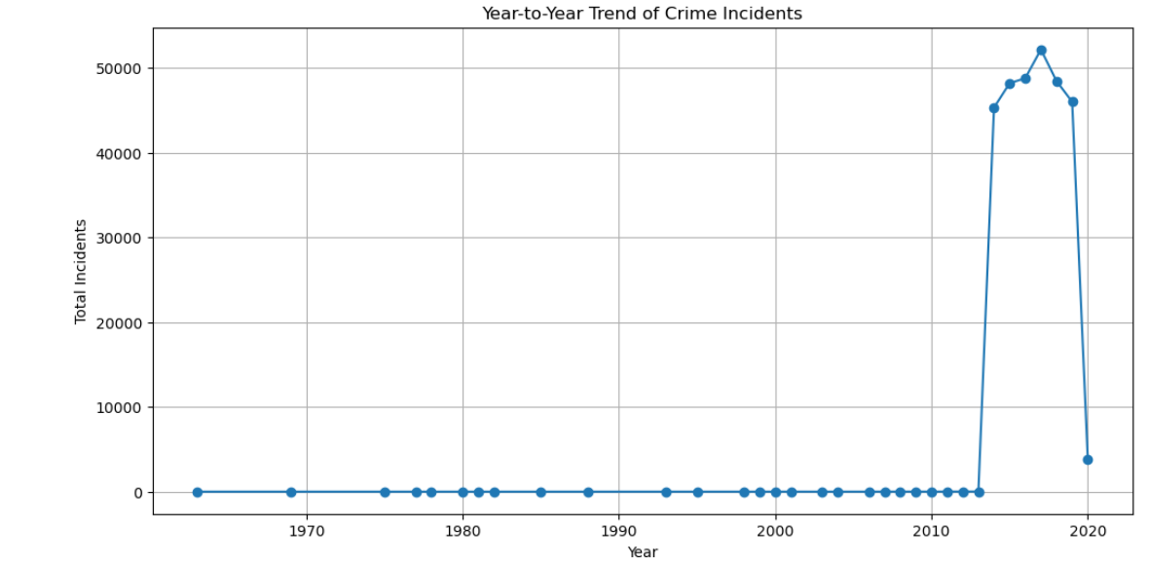
2. Generate a series of plots to describe the temporal pattern (year-to-year, monthly, and day-of-week) of the overall crime incidence aggregating from all geo-locations
Year-to-year
After 2010, there is a rise in the graph which indicate increase in cases. In 2020, there is drop might be because of lockdown.

Slide 6
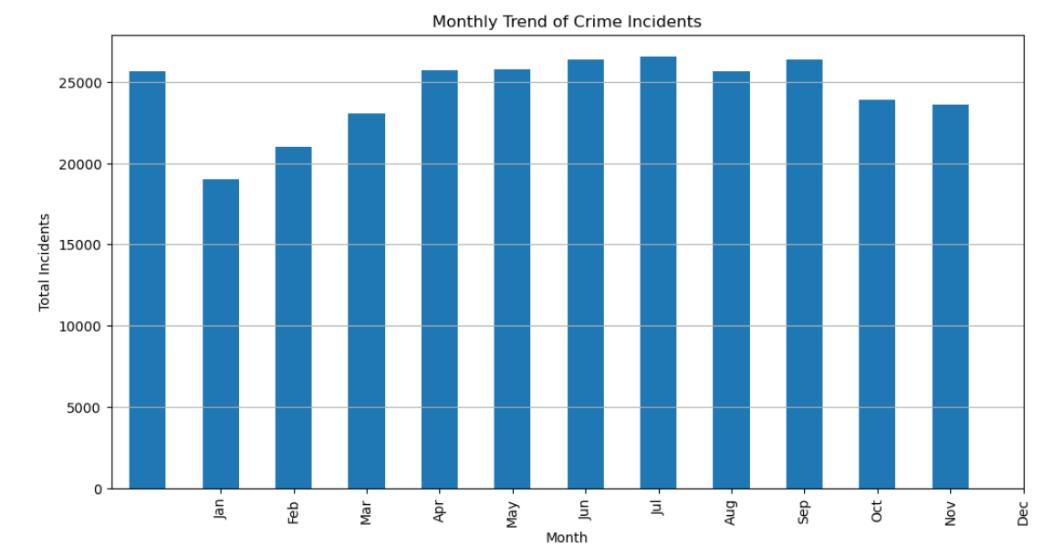
Monthly
Based on the bars, most of the incidents happened on september month.

Slide 7
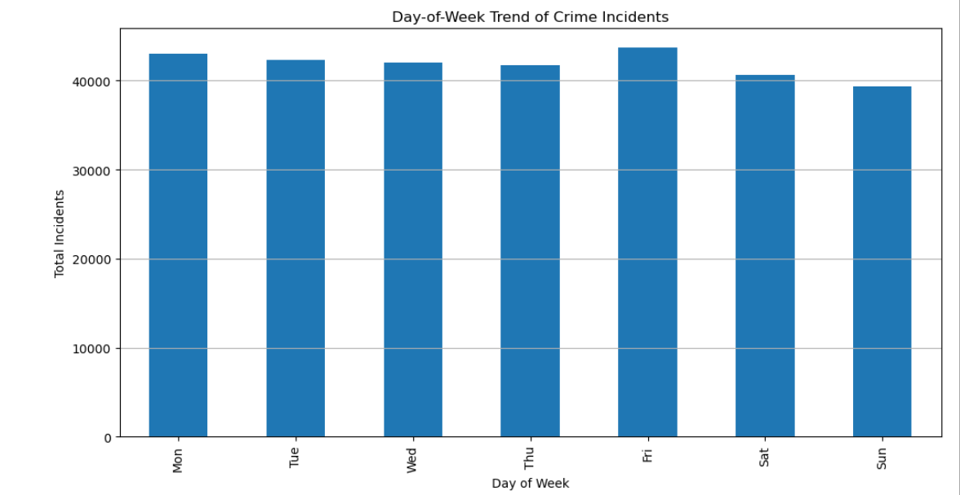
Day-to-week
Most of the incidents happened on friday. I assume people spend late nights outside of home so there is high possibility for crime incidents.

Slide 8
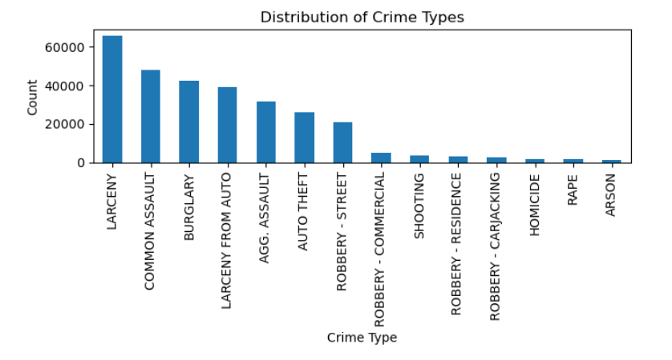
3. Generate a plot describing the distribution of crime type aggregating from all geo-locations and all time periods
Most of the crime type is Larceny and least is Arson. Personal belonging which is very value will be reported to police and less valued items are ignored.

Slide 9
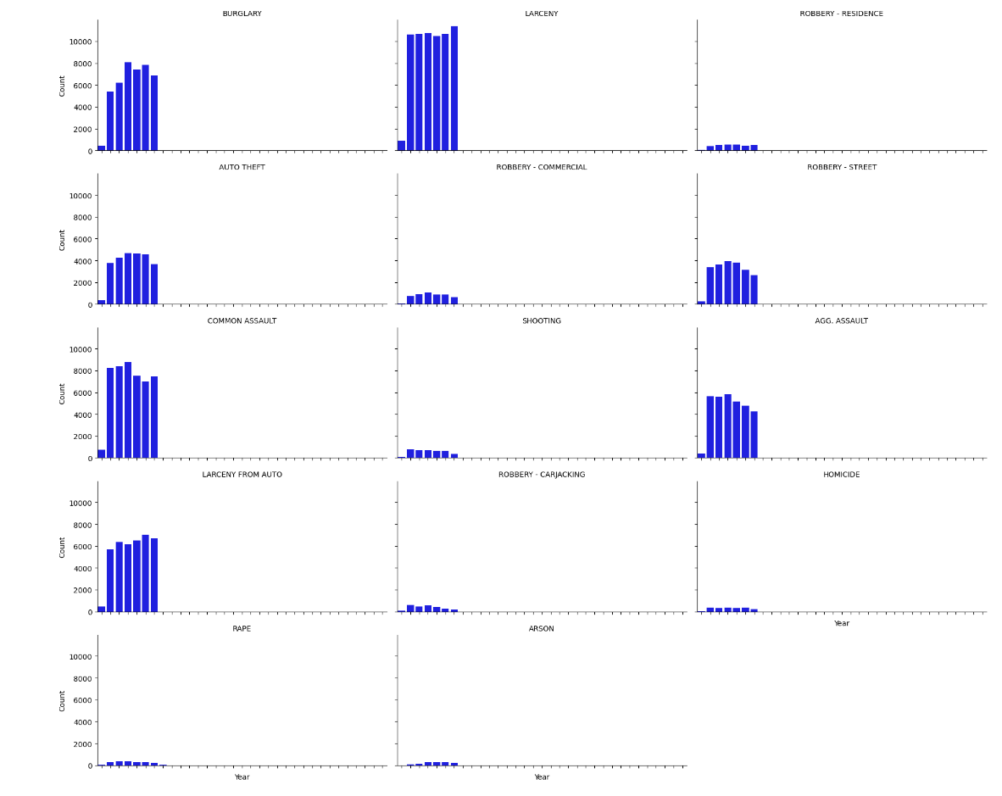
4. Generate a series of plots to illustrate how crime type distributions might vary from year-to-year, month-to-month, or by day-of-week aggregating across all locations
Year-to-year:
There are high amount of spikes for Larceny throughout the year

Slide 10
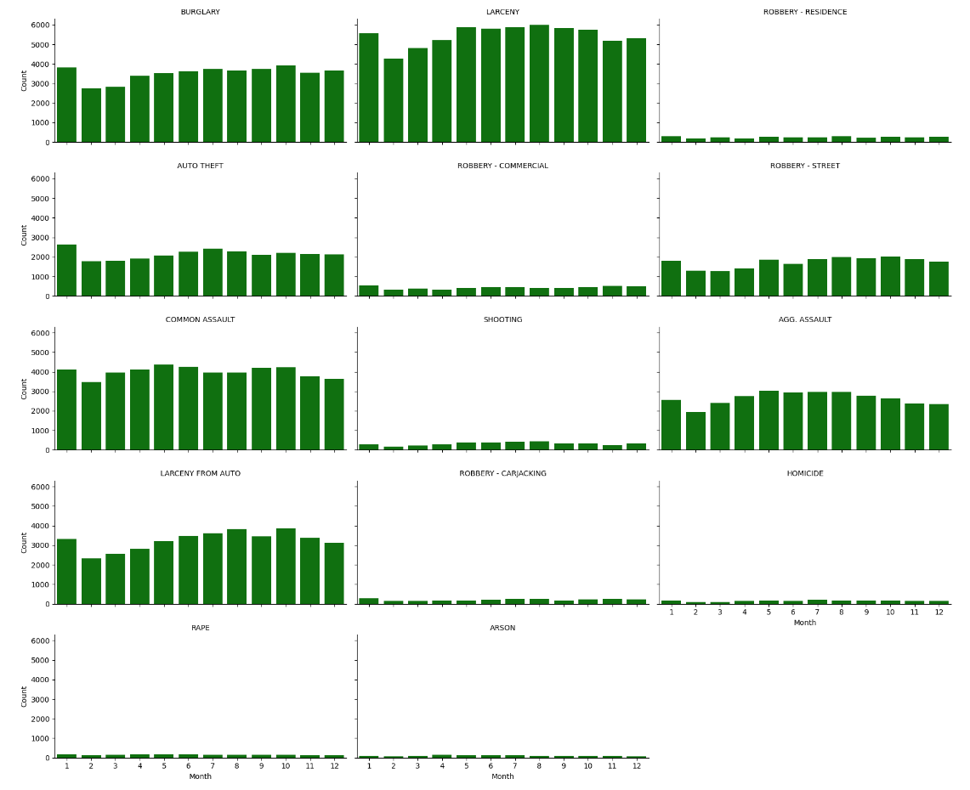
Monthly:
As expected high spikes for Larceny and low for Arson.

Slide 11
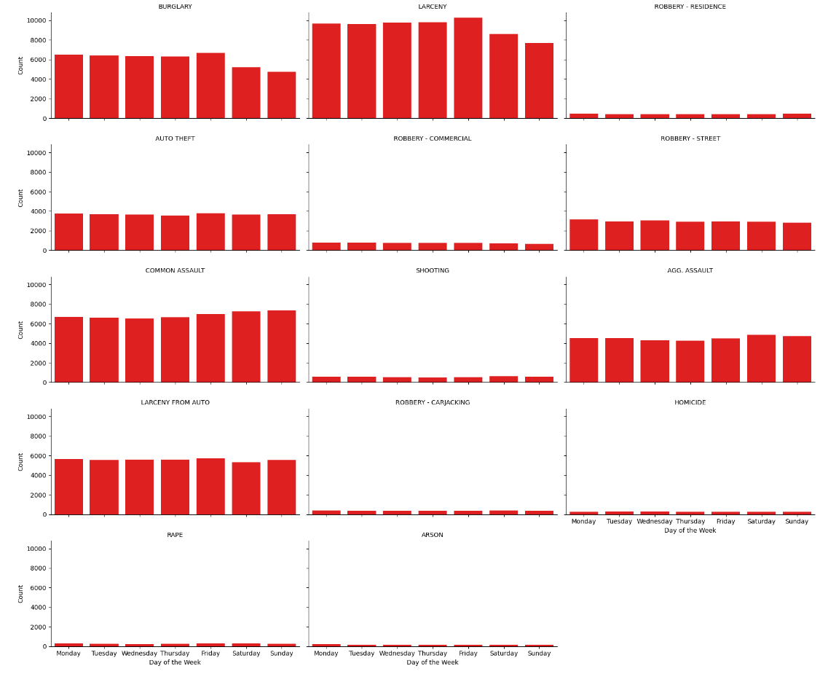
Day-of-week:
As expected high spikes for Larceny and low for Arson.

Slide 12
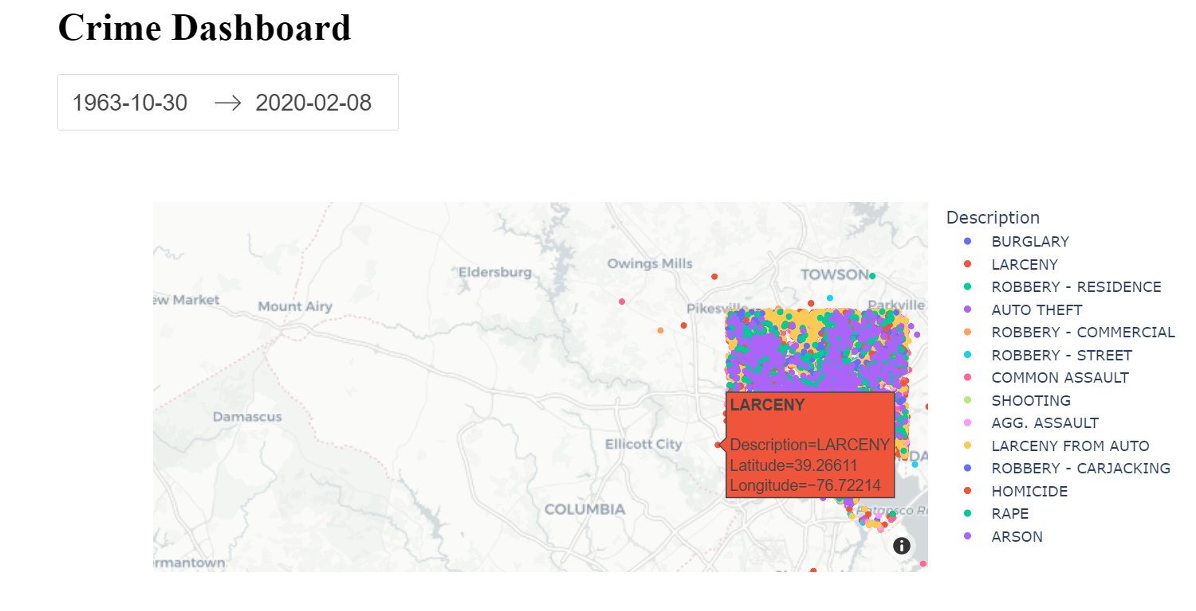
5. Design a dashboard that allows users like Gary to explore the spatial and temporal patterns of crime. You may get inspiration from tasks 2-4, but feel free to add insights. Bonus: Create a real dynamic dashboard that allows users to change parameters such as location and time period
Dashboard implements selection of date, location. Dot display description, latitude and longitude.

Slide 13
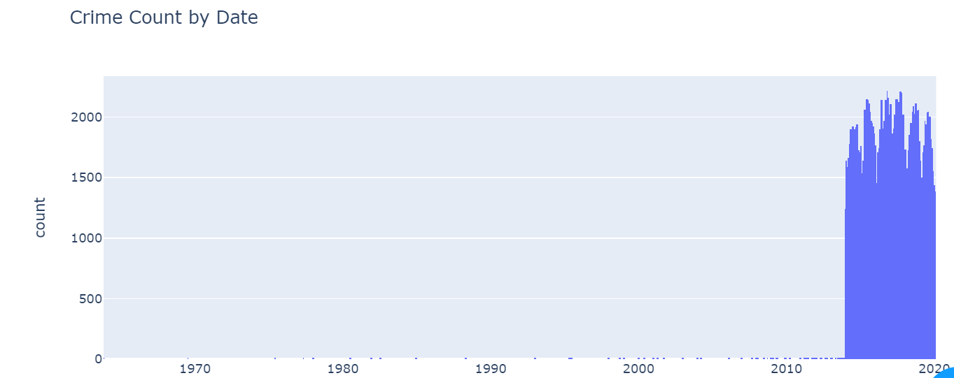
There is spike in the graph between 2010 and 2020.

Slide 14
Summary
As a initial step, data cleaning like dropping missing values, changing datatype is performed.
Based on the graph observation
After 2010, there is a rise in the graph with indicate increase in cases. In 2020, there is drop might be because of lockdown.
Based on the bars, most of the incidents happened on september month and Majority of the incidents happened on friday.
Most of the crime type is Larceny and least is Arson.

